Slide 2
Learning Objectives
Concepts of Electro magnetic waves
Parameters of Electro magnetic waves
Electro Magnetic Spectrum
Bands of E.M. Spectrum for communication
Frequencies used by common wireless technologies and standards
Signal
Analog Vs. Digital Signal

Slide 3
Analog vs. Digital signal
Analog signal
Continuous signal
Uses continuous range of values to represent information
denoted by sine waves
Analog technology records waveforms as they are
Sine waves
Digital signals
discrete time signals
denoted by square waves
Uses discrete or discontinuous values to represent information
Samples analog waveforms into a limited set of numbers and records them
Square waves

Slide 4
Bandwidth | Low bandwidth (4KHz), which means low data transmission rates (up to 33.6Kbps) because of limited channel bandwidth | High bandwidth that can support high-speed data and emerging applications that involve video and multimedia
Network capacity | Low; one conversation per telephone channel | High; multiplexers enable multiple conversations to share a communications channel and hence to achieve greater transmission efficiencies

Slide 5
Digital is rep represented as either changes in voltage or changes in light levels
Power requirement | High because the signal contains a wide range of frequencies and amplitudes | Low because only two discrete signals—the one and the zero—need to be transmitted
Low bandwidth (4KHz), which means low data transmission rates (up to 33.6Kbps) because of limited channel bandwidth | High bandwidth that can support high-speed data and emerging applications that involve video and multimedia
Security | Poor; when you tap into an analog circuit, you hear the voice stream in its native form, and it is difficult to detect an intrusion | Good; encryption can be used

Slide 6
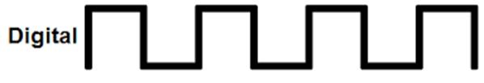

Analog vs. Digital Representation
Analog Signal
Digital Signal

Slide 7
Electro magnetic waves
Electrons when propagated either in a guided media or free space follow a wave like pattern
They have both an electrical as well as a magnetic field associated with them
Hence the name electro magnetic waves
Phenomenon was first predicted to exist by James Maxwell, in 1865, and it was first produced and observed by Heinrich Hertz in 1887
All of these waves vary with time in direction and intensity.
They move with speed of light in vaccum ; Speed decreases after entering materials
They move through vacuum, and do not need a medium to travel

Slide 8
Examples in day to day life
Light
Voice
Radio waves…..

Slide 9
Representation of E.M. wave
Function of Time
Function of Frequency
AMPLITUDE
AMPLITUDE
TIME
FREQUENCY

Slide 10
Periodic vs. Aperiodic waves
AMPLITUDE
AMPLITUDE
TIME
TIME
Periodic wave: Repeats itself over time
(Sine wave )
Aperiodic wave: Does not repeats itself over time

Slide 11
Mathematical representation
S(t)= A sin (2 Л f t + Ф)
A = Amplitude; f = Frequency; t = Period;Ф = Phase
A
AMPLITUDE
TIME
t

Slide 12
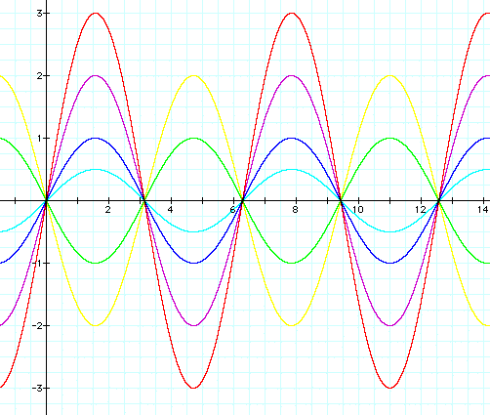
Parameters of E.M. wave
Amplitude
Maximum value or strength of the signal over time
Unit is volts
A = 1
A = 2
A = 3
A = -1
A = 0.5
A = -2

Slide 13
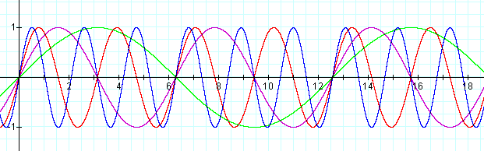
Parameters of E.M. wave
Frequency(ν): Number of cycles per unit time. Unit is hertz
Time period(T) : Amount of time taken to complete one cycle. Unit is sec, ms…etc.
T = 1/f
f = 3; T = 1/3 sec.
f = 1 ; T = 1 sec
f = 2 ; T = 1/2 sec
f = 0.5 ; T = 2sec

Slide 14
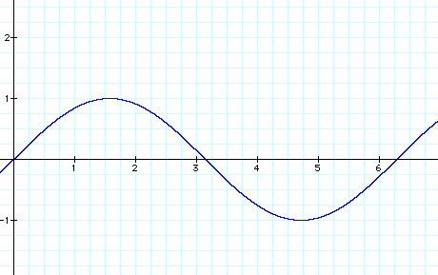
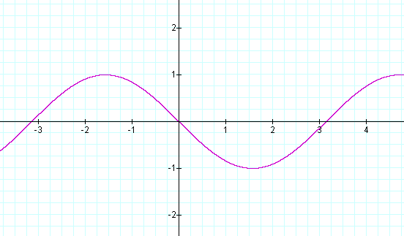
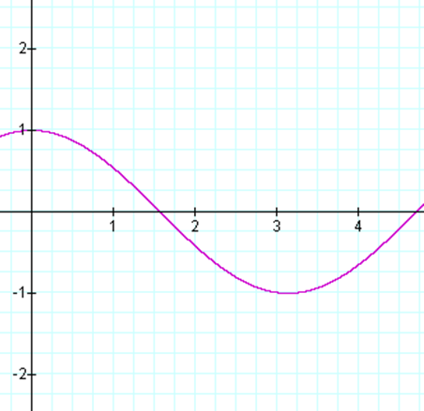
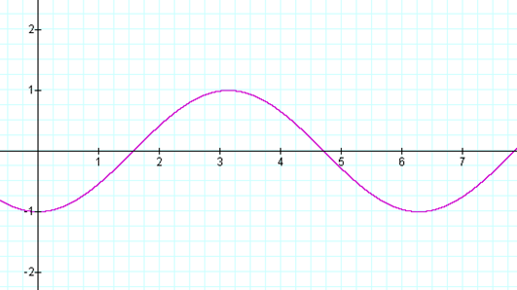
Parameters of E.M. wave
Phase shift : 0
Phase shift : 180
Phase Shift
Shift from the origin
Unit is degrees or radians
A negative phase shift indicates a movement to the right, and a positive phase shift indicates movement to the left.
Phase shift : 90
Phase shift : -90

Slide 15
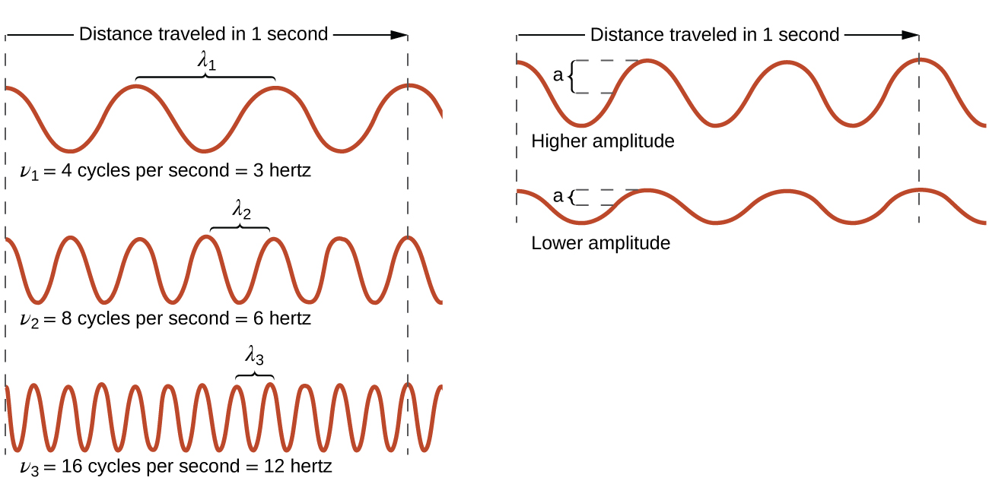
Parameters of E.M. wave
Wave Length
Distance covered by one cycle. Distance between two peak values of a wave
Represented by symbol λ
Unit is unit of distance
As frequency increases, wavelength decreases
ν α 1/ λ or ν λ = c; where c is speed of light

Slide 16
Communication entities: Data, Signals, Transmission and Channel
Data is the entity that is to be exchanged between different computers(voice, number, image..)
Signals electrical or electromagnetic representation of data
Data transmission is communication of data by the transmission or propagation of electromagnetic signals through either wired/wireless media (channel)

Slide 17
Parameters of E.M. wave
Spectrum: Range of frequencies comprising a signal
Bandwidth: Width of Spectrum
f = 3; t = 1/3 sec.
f = 1 ; t = 1 sec
f = 2 ; t = 1/2 sec
f = 0.5 ; t = 2sec

Slide 18
Frequency perspective or Time perspective for communication
Radio channels, satellite TV channels, mobile communication signals, Wireless LAN signals all coexist together in the free space medium without interference!!.
HOW???
They Operate on different range of frequencies

Slide 19
Electro Magnetic Spectrum
Electromagnetic radiation is transmitted in waves or particles at different wavelengths and frequencies.
This broad range of wavelengths is known as the electromagnetic (EM) spectrum.
The spectrum is generally divided into seven regions in order of decreasing wavelength and increasing energy and frequency.
The common designations are radio waves, microwaves, infrared (IR), visible light, ultraviolet (UV), X-rays and gamma-rays.

Slide 20
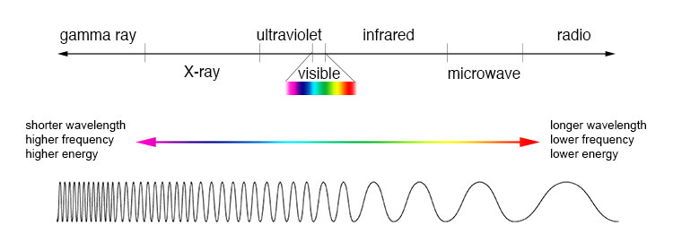
Electro magnetic spectrum
The electromagnetic spectrum is the range of all possible frequencies of electromagnetic radiation

Slide 21
Frequencies and wavelengths of bands of E.M. Spectrum
Name | Wavelength | Frequency (Hz) | Photon Energy (eV)
Gamma ray | Less than 0.01 nm | More than 10 EHz | 100 kev – 300+ GeV
X – ray | 0.01 – 10 nm | 30 EHz – 30 PHz | 120 eV – 120 keV
Ultraviolet | 10 nm – 400 nm | 30 PHz -790 THz | 3 eV – 124 eV
Visible | 390 nm – 750 nm | 790 THz – 405 THz | 1.7 eV – 3.3 eV
Infrared | 750 nm – 1 mm | 405 THz – 300 GHz | 1.24 meV – 1.7 eV
Microwave | 1 mm -1 meter | 300 GHz – 300 MHz | 1.24 µ eV – 1.24 meV
Radio | 1 mm - km | 300 GHz – 3 Hz | 12.4 feV – 1.24 meV

Slide 22
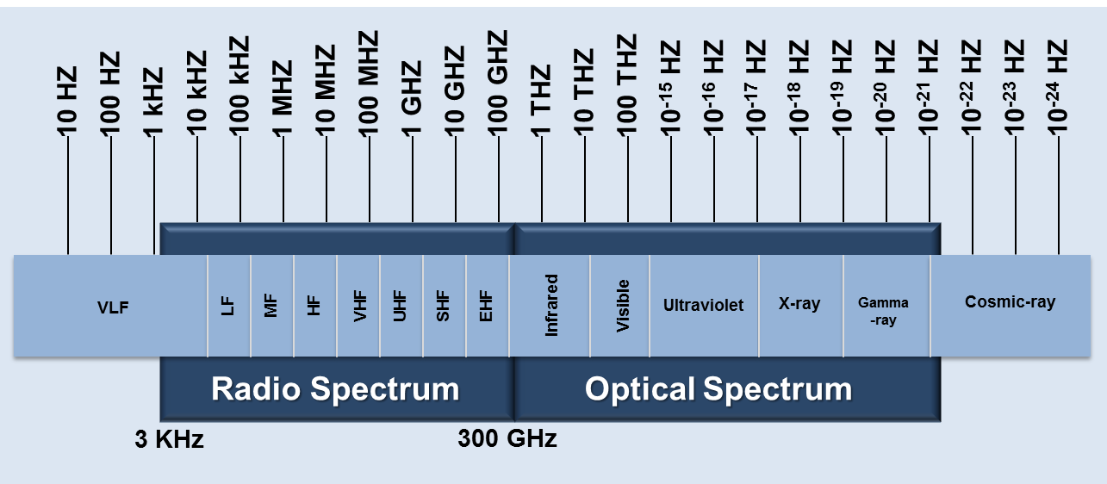
Bands suitable for communication
Radio Waves
Micro waves
Infra red waves
Visible spectrum

Slide 23
Features of Radio Waves
The lowest frequency portion of the electromagnetic spectrum is designated as "radio," generally considered to have wavelengths within 1 millimeter to 100 kilometers or frequencies within 300 GHz to 3 kHz
They can travel long distances carrying message
Can travel along Earth’s surface as in Ground Waves
At higher wavelengths, can travel under water, as required in submarine communication
It has different penetration through the walls of the buildings or houses based on the frequency making it appropriate for radio and television transmission and for cellular mobile phone service useful for both indoor and outdoor communications

Slide 24
Features of Radio Waves
It is able to bounce off the ionosphere and could travel around the world
They are easy to generate
Antenna size for Radio wave are in the range of millimetres to metres, which is feasible to make
They have same velocity in vacuum
They are omni-directional hence can be used for broadcasting in all directions
Radio waves are used for multi-casting, in which there is one sender but many receivers such as AM and RM radio, television, maritime radio, cordless phones and paging
Behaviour depends on frequency

Slide 25
Features of Radio Waves
Uncontrolled radiation of RF affects pre-adolescent childrens , pregnant women, elderly humans, patients with pace makers, small birds, flora and fauna, small insects etc.
The areas near RF cellular towers have been observed with more lightening compare to other areas. It also affects some of the fruits grown near the RF tower areas
As RF waves are available both in LOS and non LOS regions of transmitter, it can be easily intruded by the hackers and crucial personal/official data can be decoded for malicious motives

Slide 26
Features of Micro Waves
High frequency; large amount of information can be transmitted therefore cost efficient
Meticulous circuitry is required at the receiving end
Antenna size small…massive towers not needed
Travel faster; more reliable less maintenance is required
Can travel through short distances due to higher frequency
Can travel through atmospheric layers making them suitable for satellite communication
Use directional antennas hence applicable in hilly remote areas where directionality is required

Slide 27
Features of Radio Waves
Line-of-sight transmission; signal has to be transmitted several times in different directions for propagating signal
Obstructed easily
Microwave radio communication can also be degraded by heavy moisture in the atmosphere, snow, rain and fog, in a phenomenon known as rain fade.

Slide 28
Limitations of radio propagation
Increasingly limited availability of conventional bandwidths for electronic equipment
Licensing of bands
Radio communications interference with sensitive electrical equipment
Data security
Negative health consequences on environment

Slide 29
Optical Communication

Slide 30
Infra red waves
The wavelength of infrared radiation varies from about 750 nanometres (the near infrared) to 1 millimetre (the far infrared). Frequencies range from about 300 GHz to 400 THz. I
Infrared transmitters are usually relatively directional, cheap, lightweight, reliable and easy to manufacture.
The main disadvantage is that infrared light will not pass through solid objects.
On the plus side, an infrared system in one room of a building will not interfere with similar systems in nearby rooms, and the possibility of eavesdropping is far lower than with radio-based systems

Slide 31
Features of Infra red Waves
The wavelength of infrared radiation varies from about 750 nanometres (the near infrared) to 1 millimeter (the far infrared).
Frequencies range from about 300 GHz to 400 THz
An infrared transmitting device, either a light-emitting diode (LED) or a laser diode, converts an electrical signal to an optical signal.
LEDs have a naturally wide transmission path and are suitable for short-range applications. They are also much safer than laser diodes for indoor use.
Laser diodes have narrow transmit beams and a relatively narrow spectral width, making them more suitable for point-to-point long-range applications.
The transmitted signal's intensity or power is proportional to the modulating signal
Photodetector at the receiver produces an output current proportional to the received optical signal intensity;Contemporary application is TV remote control

Slide 32
Features of Infra red Waves
Infrared Data Association (IrDA), set up in 1993 to develop standards for infrared communication hardware software and communications protocol standards for short-range data communications in applications such as personal area networks (PANs)
Infrared laser systems can also be used for long-range communication
up to about 2.4 kilometers
with a maximum projected data rate of 16 Mbps
Point-to-point (line-of-sight) systems
Sensitive to fog and other atmospheric conditions
Building to building transmission link

Slide 33
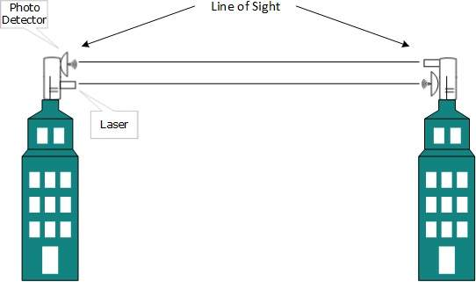
Point-to-point communication

Slide 34
Features of Infra red Waves
Diffuse (or non-line-of-sight) systems may be used for wireless LAN connectivity, in which the link between transmitter and receiver is maintained by "bouncing" the transmitted signals off reflecting surfaces such as walls and ceilings
The specifications for infrared wireless LANs are covered in the IEEE 802.11 standard

Slide 35
Features of Infra red Waves
Infrared transmitters are usually relatively directional, cheap, lightweight, reliable and easy to manufacture
An infrared system in one room of a building will not interfere with similar systems in nearby rooms
Possibility of eavesdropping is far lower than with radio-based systems
Infrared communication is more reliable alternative for indoor wireless LANs
Easily obstructed
Harmful at high power levels
Cannot be used outside in day because of interference with sunlight

Slide 36
Visible light communication
Communicating information via light is a concept that has been around since ancient times when signal fires would relate important news across long distances
Visible light communication (VLC) is a less widely used form of communication which requires that the communication frequencies lie in the visible light spectrum
VLC methods are less pervasive because the transmitted signals are visible by people which can adversely impact their environment
A common phrase for VLC is Li-Fi (lightfidelity) after the popular Wi-Fi (wireless fidelity) communication method

Slide 37
Visible light communication
Communicating information via light is an old concept using signal fires
Visible light communication (VLC) is a form of communication which requires that the communication frequencies lie in the visible light spectrum
VLC methods are less pervasive because the transmitted signals are visible by people which can adversely impact their environment
A common phrase for VLC is Li-Fi (lightfidelity) after the popular Wi-Fi (wireless fidelity) communication method

Slide 38
Advantage over radio communication
Ultra-high-speed
High security
Biologically friendly communications
All time availability

Slide 39
Visible light communication
VLC refers to communication using an illumination source which provides illumination as well as communication
It can send information using light-signals
The signals are sent by modulating them in ON OFF patterns to transmit 0 and 1
A photoreceptor at other end demodulates into data
The sources of light used in VLC can be florescent bulbs, incandescent bulbs, lasers, or LEDs
Incandescent lights cannot sustain quick switching in ON and OFF pattern to modulate 0 & 1
In contrast, LED can be fluctuated with high frequency as it is made up of semi-conductor material
LED is also known as green lightning resource because it is energy efficient and doesn’t contain hazardous material like mercury emitted by florescent lamps
Hence LED has an edge over other sources for VLC

Slide 40
Capacity: Light has 10000 times wider bandwidth than radio waves [2]. Also, light sources are already installed. So, Li-Fi has got better capacity and also the equipments are already available. b) Efficiency: Data transmission using Li-Fi is very cheap. LED lights consume less energy and are highly efficient. c) Availability: Availability is not an issue as light sources are present everywhere. There are billions of light bulbs worldwide; they just need to be replaced with LEDs for proper transmission of data. d) Security: Light waves do not penetrate through walls. So, they can‘t be intercepted and misused.

Slide 41
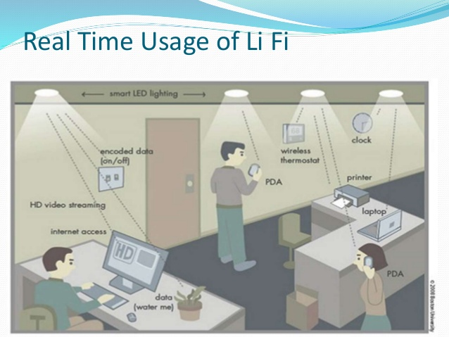

Slide 42
Although the electromagnetic spectrum represents an enormous range of frequencies, not all the frequencies are suitable to purposes of human communications. At the very low end of the spectrum are signals that would be traveling at 30Hz (that is, at 30 cycles per second). One of the benefits of a very low frequency is that it can travel much farther than a high frequency before it loses power (that is, attenuates). So a 30Hz signal provides the benefit of being able to travel halfway around the world before it requires some form of amplification. For example, one defense agency uses 30Hz to communicate with its submarines by using telemetry (for example, a message that says "We're still here. We're still here" is sent,

Slide 43
How is data put on radio waves?
There are two common ways to put information in a radio wave, and you've likely run into them yourself. They are called A.M. and F.M. just like the two choices you've always known are on a radio. To understand these two ways of sending information it is important to know that radio waves, by themselves, have very regular patterns. Generally they keep the same amplitude or frequency all the time. (Amplitude is the "height" of the radio wave, frequency is how close the waves are to each other.)
A.M. stands for amplitude modulation. In this method, the information is put into a radio wave by varying the amplitude. For example, if all we wanted to do was send 1's and 0's, we could have just two different levels of amplitude that correspond to these numbers--1 being high, 0 being low.
F.M. stands for frequency modulation. This time the amplitude is kept constant, it is the frequency that is varied..

Slide 44
In 2011, Harald Haas from University of Edinburgh, UK, demonstrated VLC through LED evolving a technology called Li-Fi which abbreviates to “LIGHT FEDILITY”

Slide 45
ƒ | λ | Band | Description
30 – 300 Hz | 10^{4 –} 10⁴ km | ELF | Extremely low frequency
300 – 3000 Hz | 10^{3 –} 10² km | VF | Voice frequency
3 – 30 kHz | 100 – 10 km | VLF | Very low frequency
30 – 300kHz | 10 -1 km | LF | Low frequency
0.3 – 3 MHz | 1 – 0.1 km | MF | Medium frequency
3 – 30 MHz | 100 – 10 m | HF | High frequency
30 – 300 MHz | 10 – 1 m | VHF | Very high frequency
300 – 3000 MHz | 100 – 10 cm | UHF | Ultra – high frequency
3 – 30 GHz | 10 -1 cm | SHF | Superhigh frequency
30 – 300 GHz | 10 – 1 mm | EHF | Extremely high frequency
www.itu.int

Slide 46
ƒ (GHz) | Letter Band Designation
1 – 2 | L band
2 – 4 | S band
4 – 8 | C band
8 – 12.4 | X band
12.4 – 18 | Ku band
18 – 26.5 | K band
26.5 – 40 | Ka band

